Slide 1
Probability and Statistics
“Probability and Statistics for engineers and scientists” by “Ronald walepole”
“probability and statistics for engineering and the sciences” by “ lay l. devore”

Slide 2
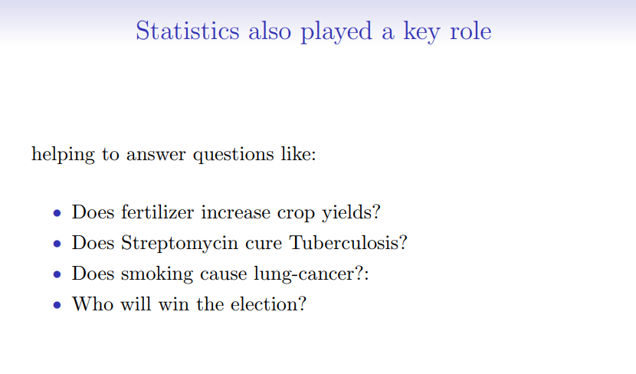

Slide 3
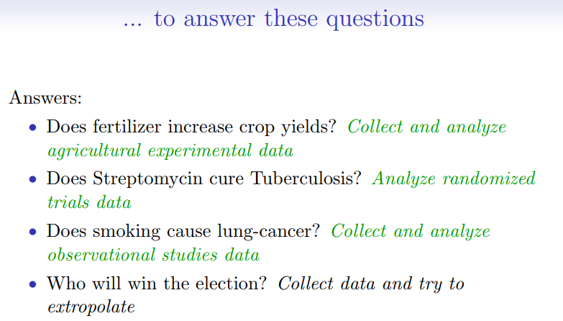

Slide 4

Statistical methods are designed to contribute to the process of making scientific judgments in the face of uncertainty and variation.

Slide 5
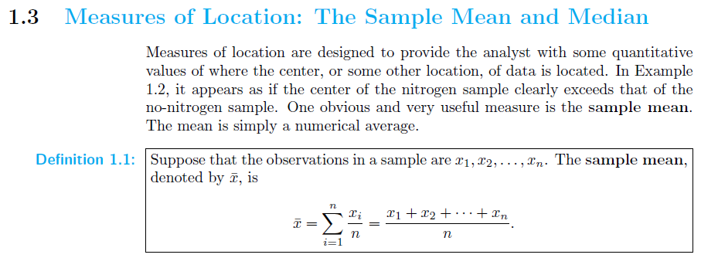




Slide 6
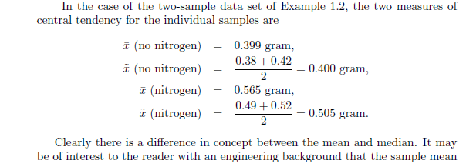
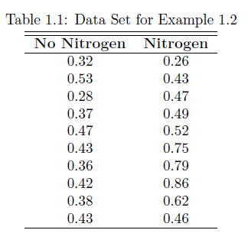




Slide 7
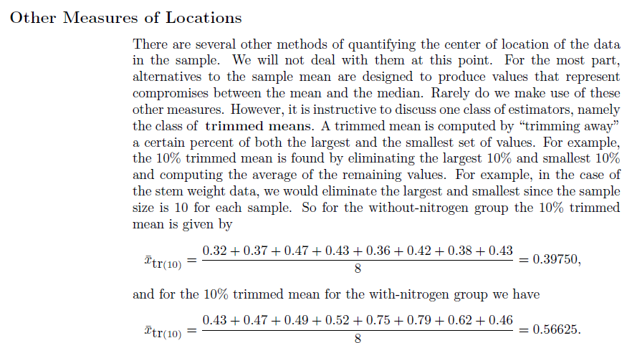

Slide 8


Slide 9
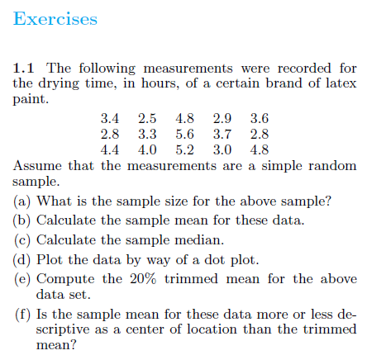

Slide 10

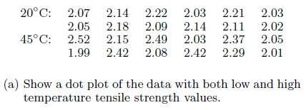
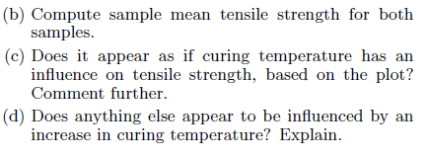

Slide 11
